Slide 1
Model Optimization
Linden Lu

Slide 2
Model Optimization
Feature Selection
Cross-Validation
Model Selection

Slide 3
Introduction to Feature Selection
Linden Lu

Slide 4
Feature Selection
Key benefits
Reduces overfitting
Improves accuracy
Reduces training time
Improves interpretability

Slide 5
Feature Selection Algorithms
Filter methods
Wrapper methods
Embedded methods

Slide 6
Filter Methods
Variance Threshold
Ranks features by variance
Feature scaling is necessary
Univariate Techniques
Relationship between individual feature and target feature

Slide 7
Wrapper Methods
Train a model with different combination of features
Recursive feature extraction

Slide 8
Embedded Methods
Rank features during training
Model dependent
Decision Tree
Random Forest

Slide 9
Introduction to Cross- Validation
Linden Lu

Slide 10
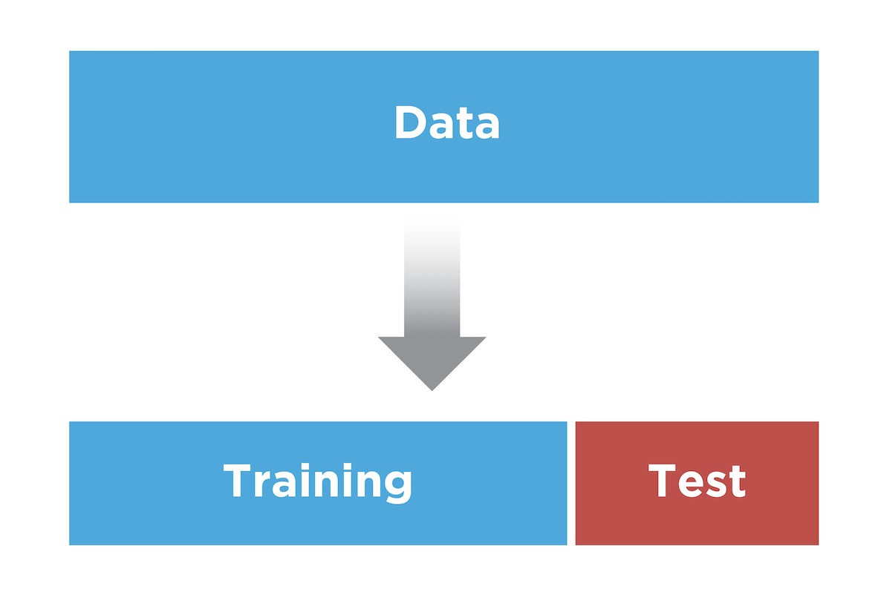
Dataset Splitting

Slide 11
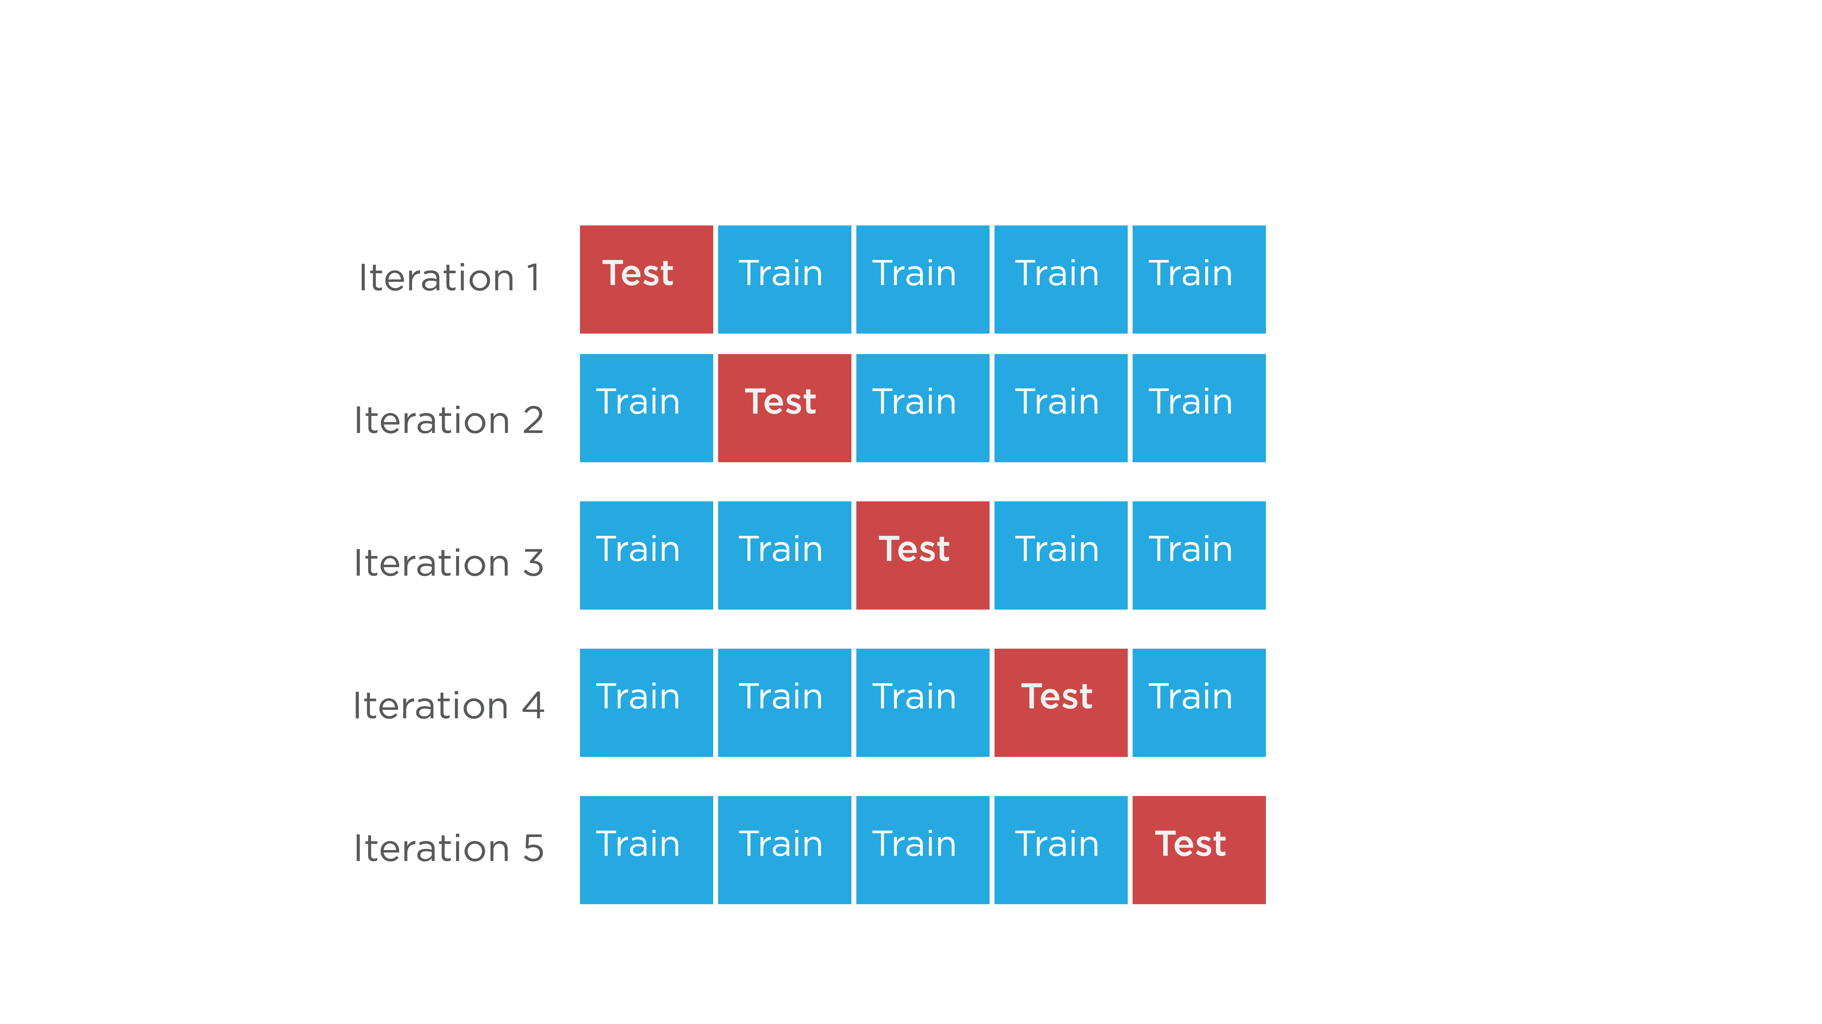
KFold Cross-Validation

Slide 12
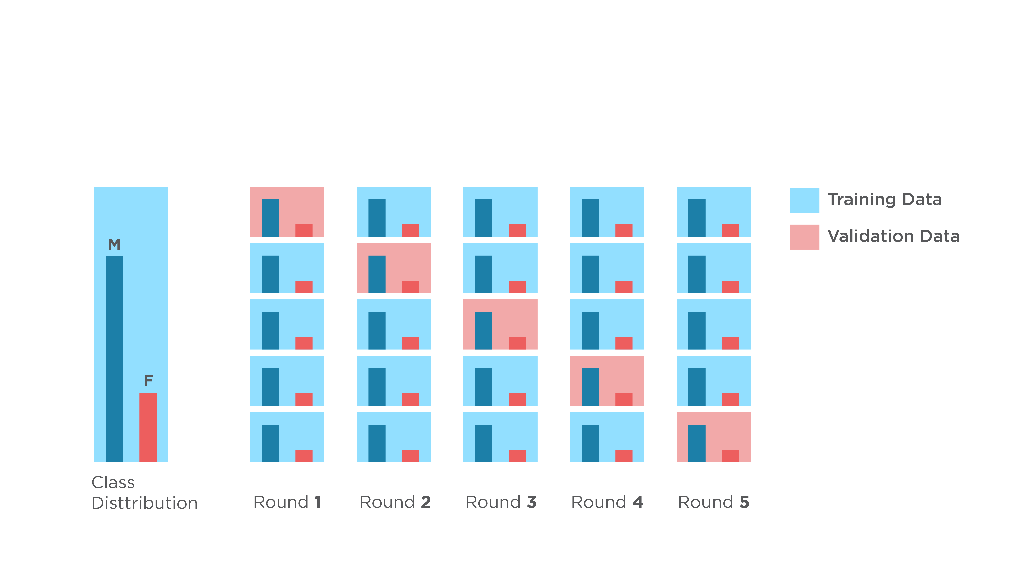
Stratified KFold

Slide 13
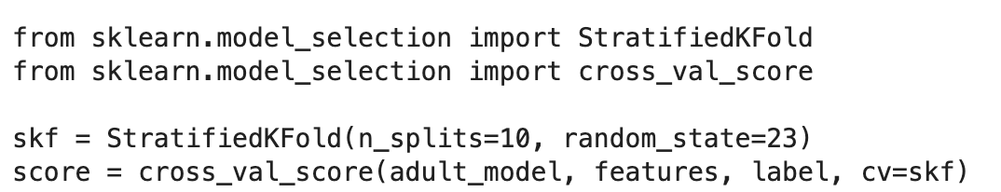
Evaluate Model with Cross-Validation

Slide 14
Custom Scoring

Slide 15
Introduction to Model Selection
Linden Lu

Slide 16
Model Selection with Cross-Validation
Grid Search
Randomized Grid Search

Slide 17
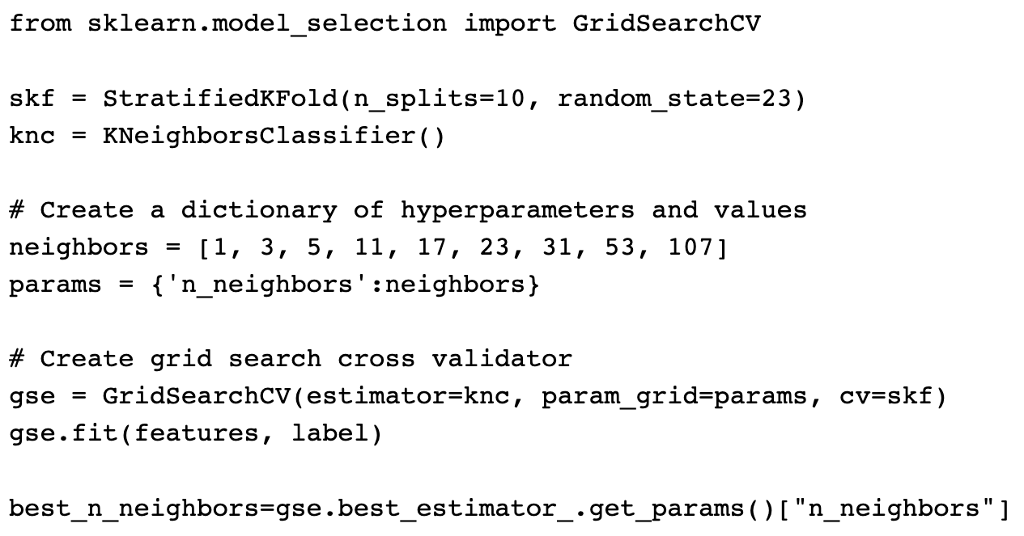
Grid Search

Slide 18
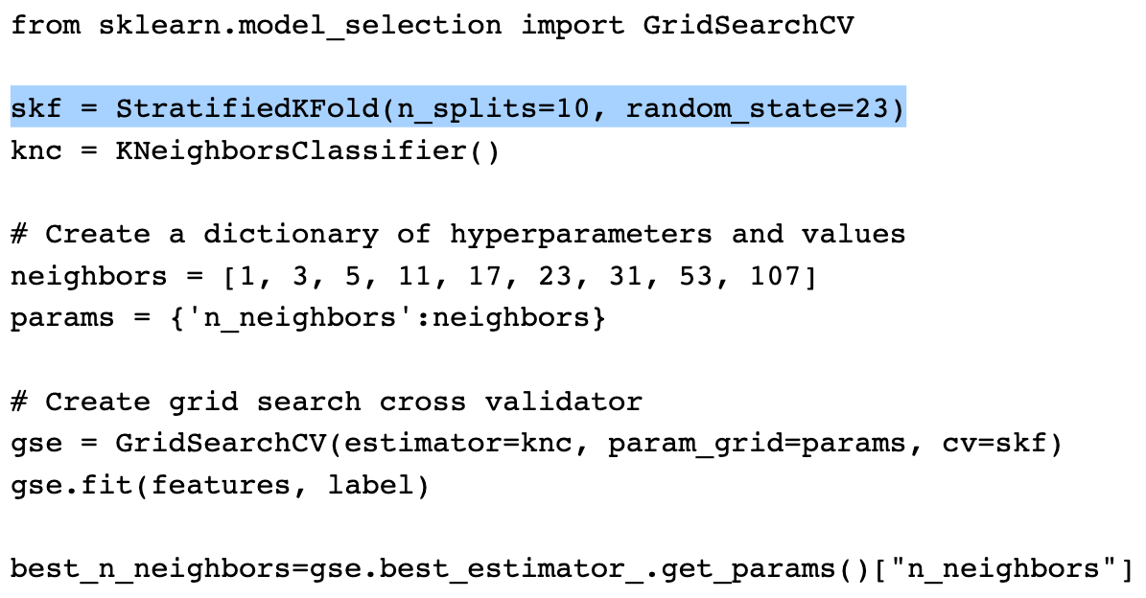
Grid Search

Slide 19
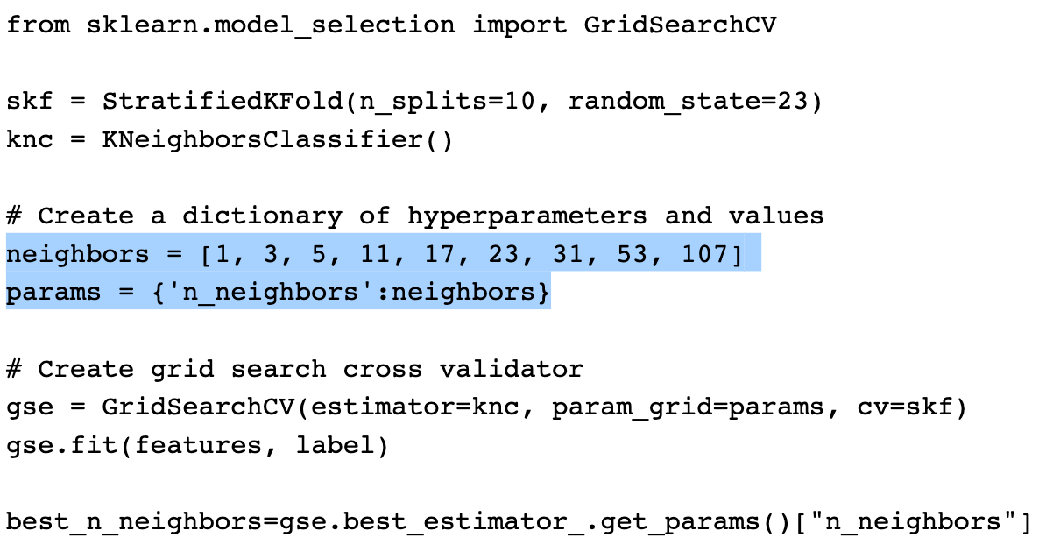
Grid Search

Slide 20
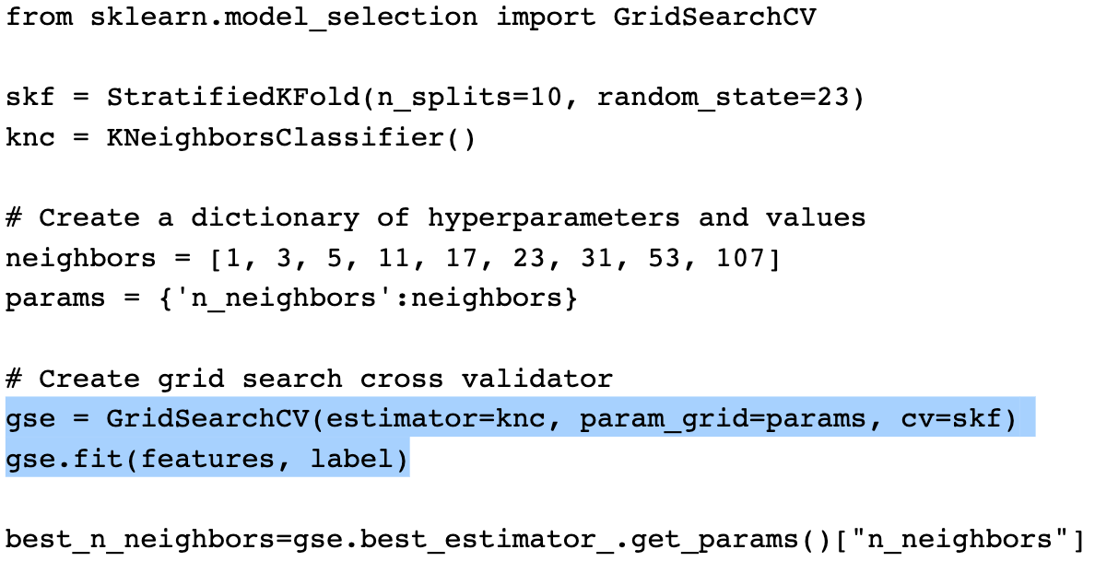
Grid Search

Slide 21
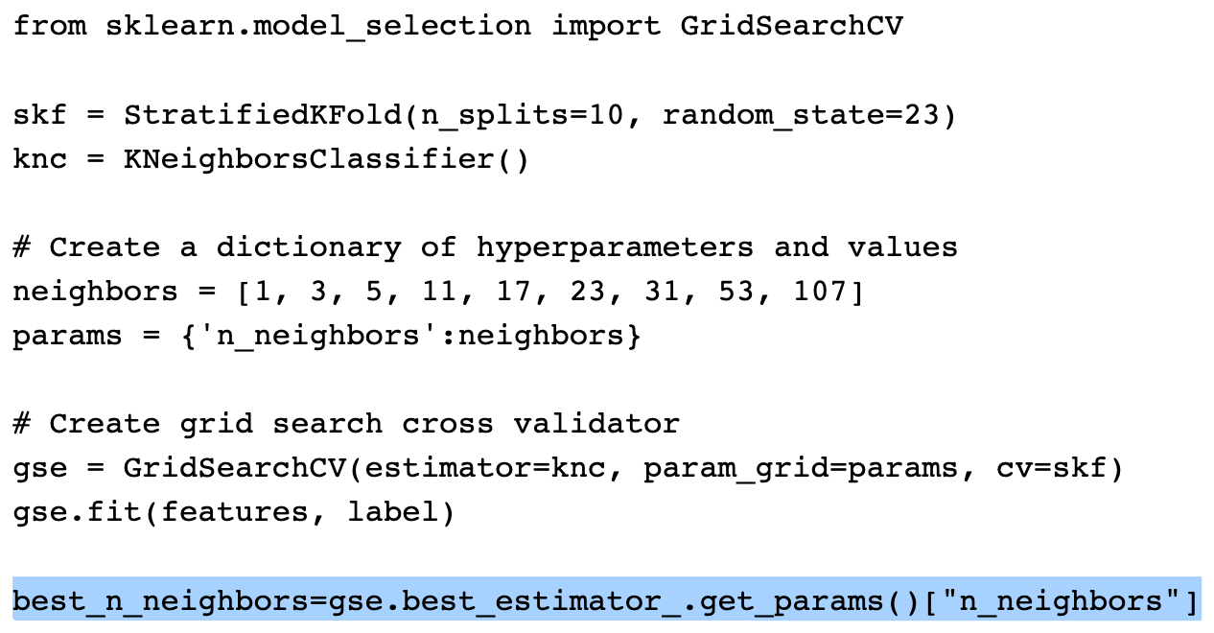
Grid Search

Slide 22
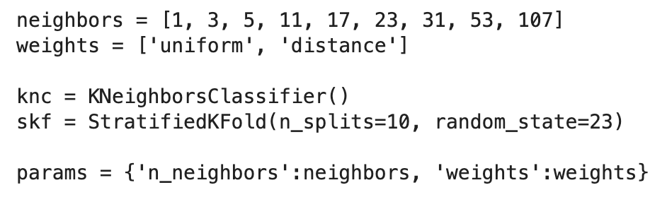
Multi-dimensional Grid Search

Slide 23
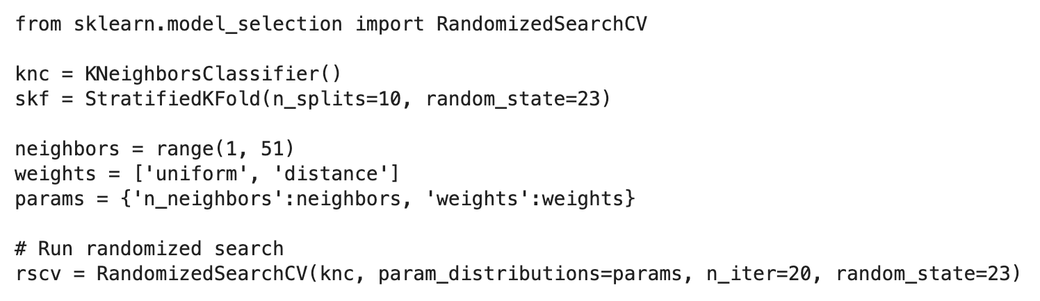
Randomized Grid Search

